Slide 1
Nested Monte-Carlo for Log-Variance-Gamma Model
Samuel Gaudin & Julien Kordes

Slide 2
Summary
1- Nested Monte-Carlo simulation
2- Neural Network approximation
3- Monotonicity and convexity study

Slide 3
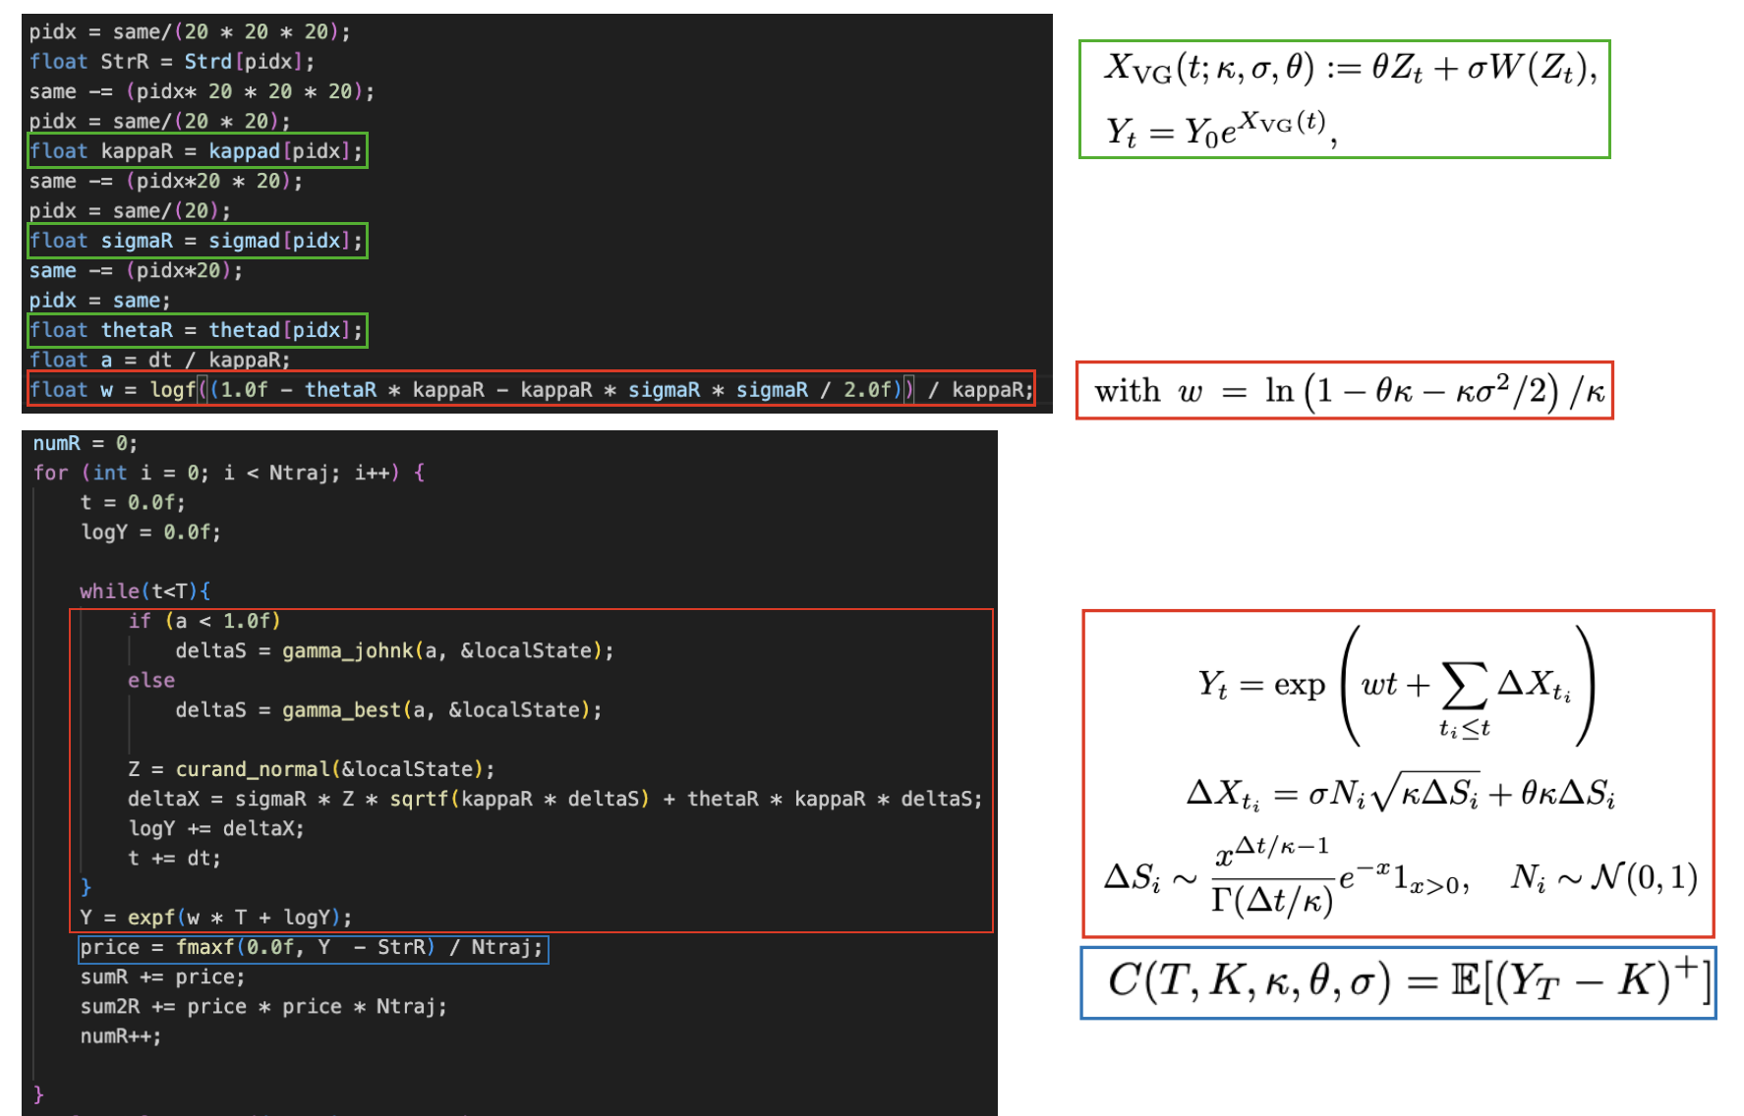
Monte-Carlo simulation
Variance-Gamma Process

Slide 4
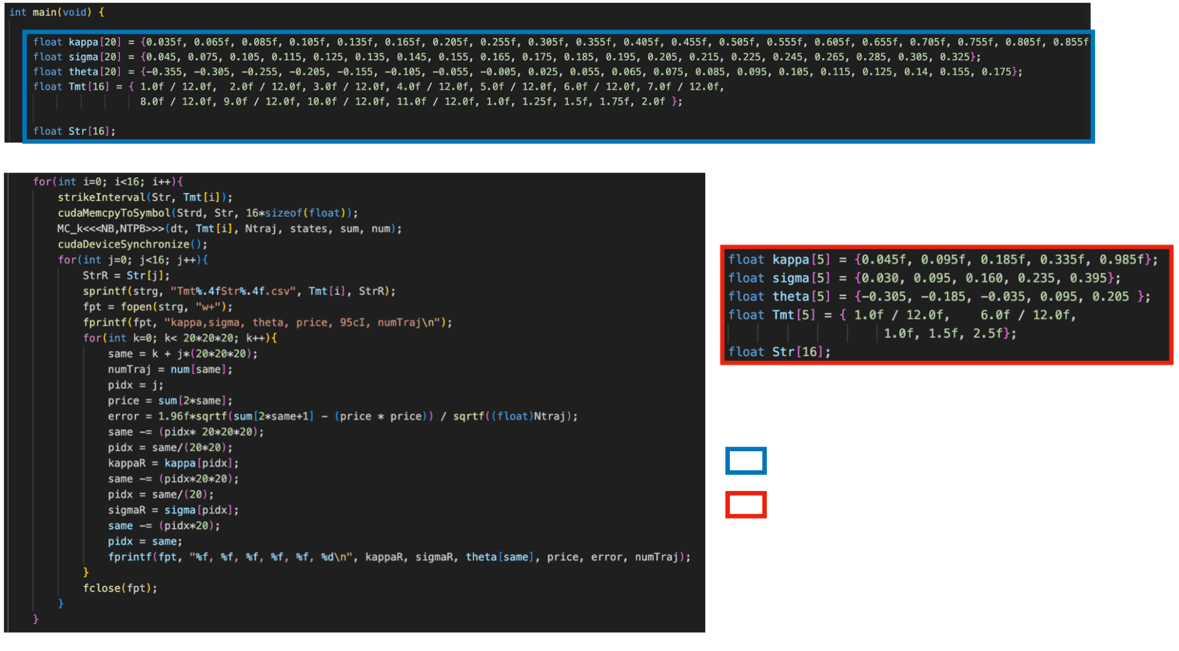
Parameters initialisation :
Training with Ntraj = 64 * 512
Testing with Ntraj = 256 * 512

Slide 5
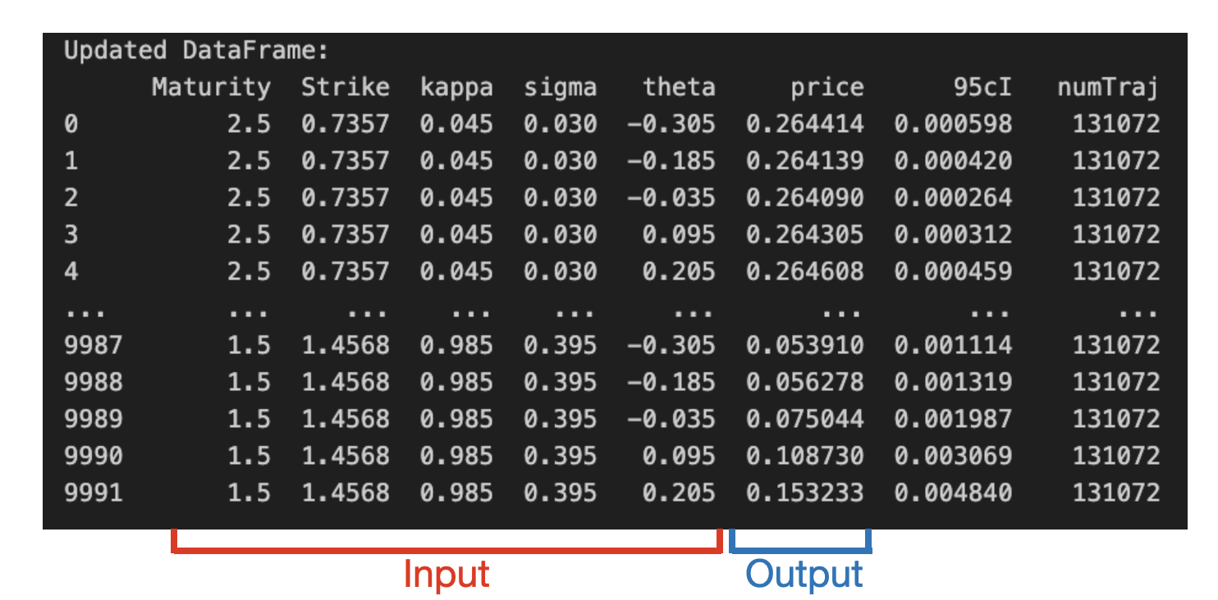
Neural Network approximation

Slide 6
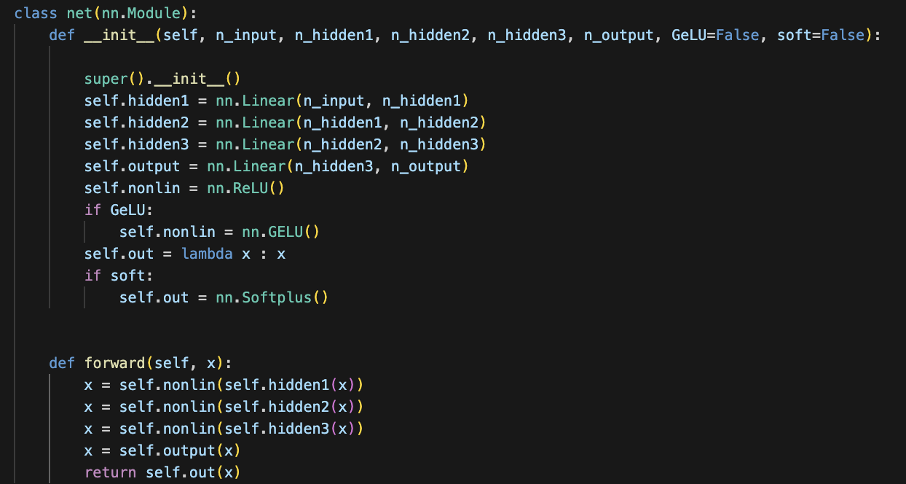
Neural Network approximation
Parameters: 3 hidden sizes We tested with: (200, 200, 200) (400, 200, 100)

Slide 7
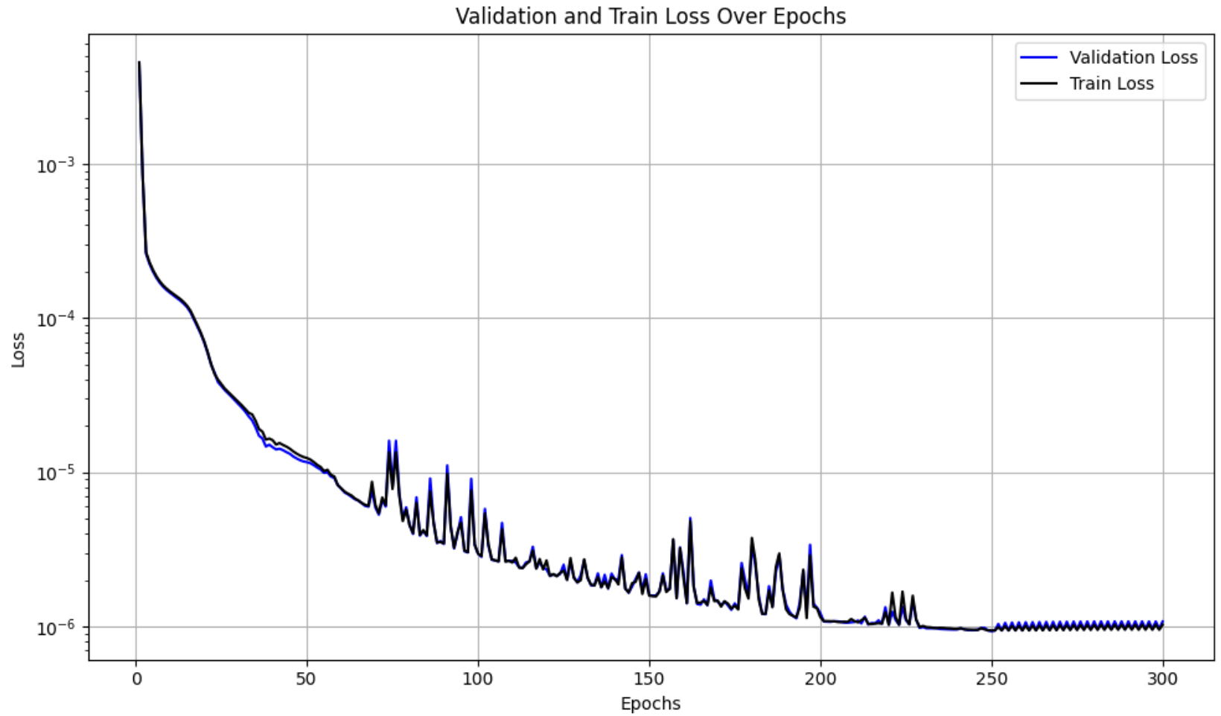
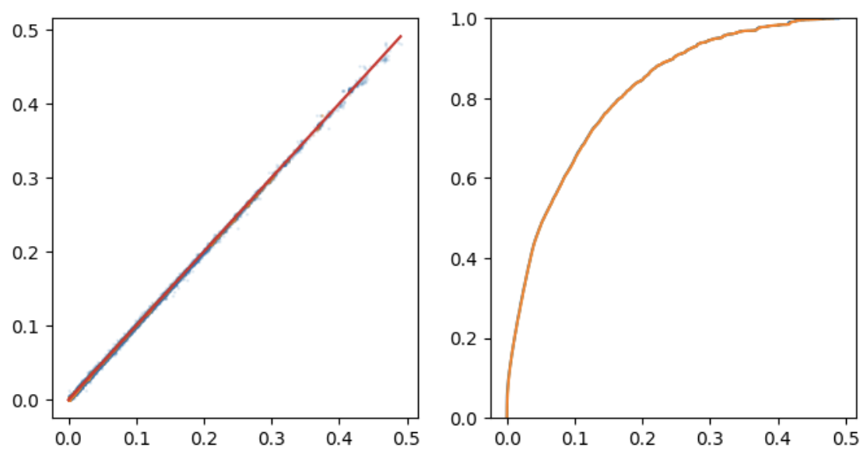
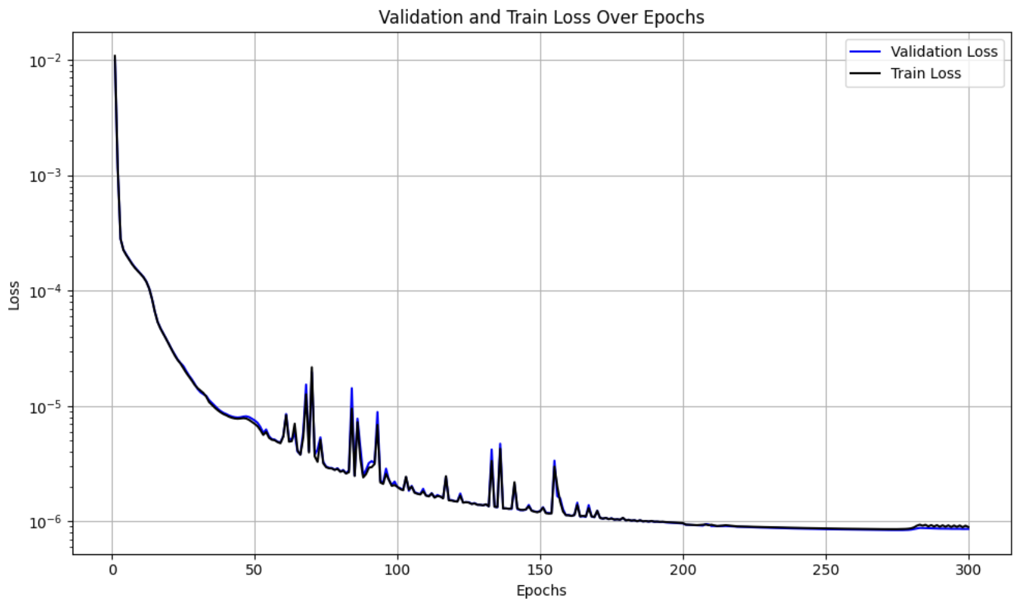
Approximation results
Hidden sizes = (200, 200, 200)
Hidden sizes | Linear correlation | R^2 coef | Accuracy | Relaxed Accuracy
(200, 200, 200) | 0.99 | 0.99 | 0.38 | 0.58
(400, 200, 100) | 0.99 | 0.99 | 0.49 | 0.65
Hidden sizes = (400, 200, 100)
Scatter plot of target vs predicted prices
Empirical cumulative distribution function

Slide 8
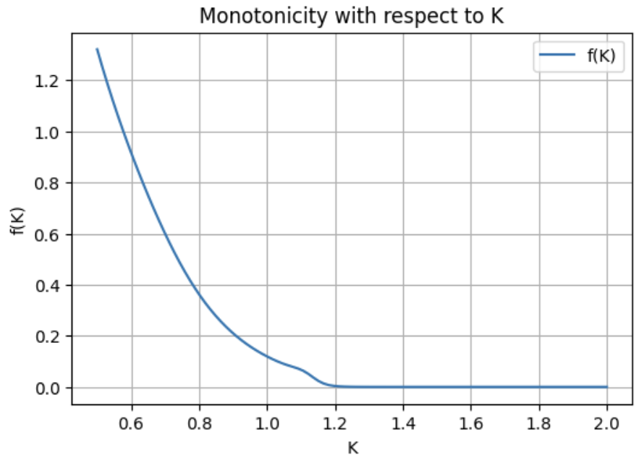
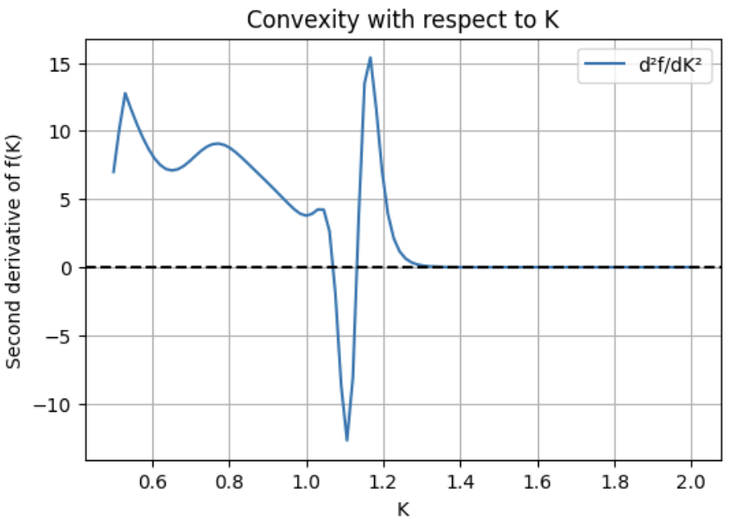
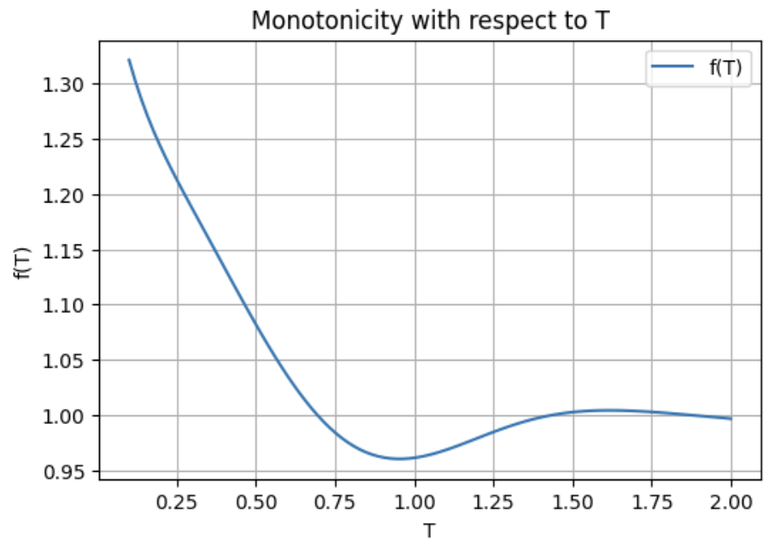
Monotonicity and convexity study

